Slide 1


Slide 2





Team :Group #1
Leyan burait
Rana Musa
Jenin Mansour
Sireen bearat
Rahaf Naser
Manager
Secretary
Technical architect
Programmer
Tester

Slide 3

Jewlery Shop
User-Friendly Website: Intuitive design with easy navigation to explore our diverse jewelry collection.
Diverse Jewelry Catalog: A curated selection of rings, necklaces, bracelets, earrings, and more, catering to various styles and preferences.
Customization Options: Personalized jewelry options, such as engraved names or initials, to make every piece unique.
Secure Online Payments: Multiple secure payment methods, ensuring customer safety and peace of mind during transactions.
Reliable Delivery Service: Timely delivery of purchases, securely packaged to maintain pristine condition.
Customer Support: Dedicated assistance available via email, chat, or phone to address inquiries and resolve issues promptly.
Feedback-Friendly Approach: Encouraging customer reviews to continually improve products and services.
Account Options: Optional account creation for saving preferences, order history, and faster checkouts.

Slide 4
Scenario: Adding items to the shopping cart
Initial Assumption:
The customer has successfully logged into his account on the online jewelry shop's website. The customer browses the shop, selects items, and adds them to the shopping cart with the intention of purchasing them.
Normal:
The customer login to his account
The customer select specific item to buy .
The customer clicks on the "Add to Cart" button for the selected item.
The system confirms the product availability and updates the shopping cart with:
-Product details (image, ID, price, rating, and quantity).
-The total cost of all items in the cart.
The customer navigates to the shopping cart section using shopping cart “icon”and reviews the item displayed in the cart.
The item details, including the image, ID, price, rating, and quantity, are clearly displayed.
The total price of all items in the cart is shown at the bottom of the screen, and the total cost remains visible even when scroll down the page.
The customer confirms the item quantity and price.
The customer decides to purchase the item..

Slide 5
Scenario
What Can Go Wrong?
Adding the Same Item Twice
Alternative: The customer browsed the shopping cart and decided to add the same product again. The customer clicks on the “+” button appearing next to the item to increase the quantity of the item, instead of browsing for the product again and adding it. The system then successfully updates the quantity and recalculates the total price accordingly.
. System Fails to Update Cart
Error:The customer clicks on the "Add to Cart" button for a specific item. The customer navigates to the cart but does not find the item displayed. The system fails to retrieval the item from the database and add it to the cart. The customer cannot proceed with the purchase.The system should notify the customer about the error and offer options to retry the action.The system logs the issue for technical support to resolve, and the customer can contact customer support via life chat to solve the issue.

Slide 6
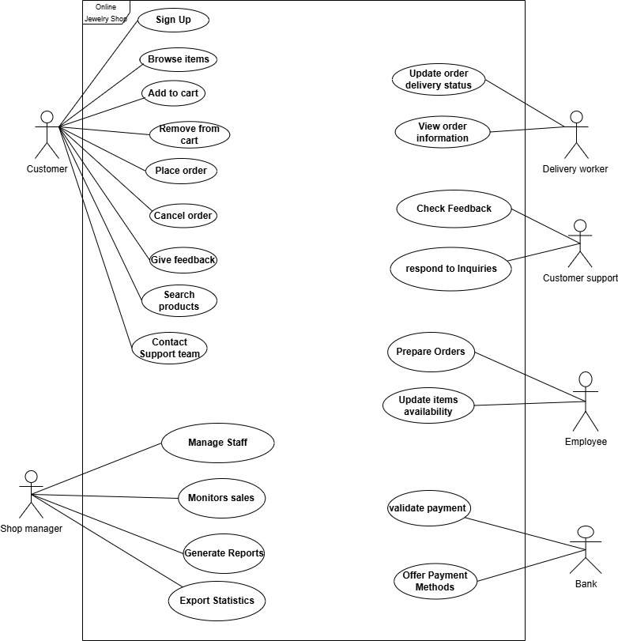
Use Case Modelling

Slide 7
Scenario Analysis :
Actors : Customer , Customer support team
Description: The customer browse the online shop, and select item to add to the cart, the customer reviews the cart to confirm or modify item quantities and confirm total price, then decides whether to proceed with the purchase or continue browsing.
Pre-conditions:
1-The customer is successfully logged into the system.
2- The item exists in the online shop and available for purchase.
Sequence/Flow of Events:
The customer logs into his account The customer selects an item and clicks the “Add to Cart” button The customer accesses the shopping cart by clicking the cart icon displayed on any page. 3.1. The system displays the item in the shopping cart with its details (image, ID, price, and quantity). 4. The customer reviews the cart to confirm or modify item quantities. 4.1. If the customer decide to add the same item 4.1.1- The customer clicks "+" to increase the item quantity. 4.1.2- if the process succeed the system updates the item quantity and total cost based on the new quantity. 4.1.3- If the process not succeed System informs customer to retrying.The system logs the issue for technical support to resolve,

Slide 8
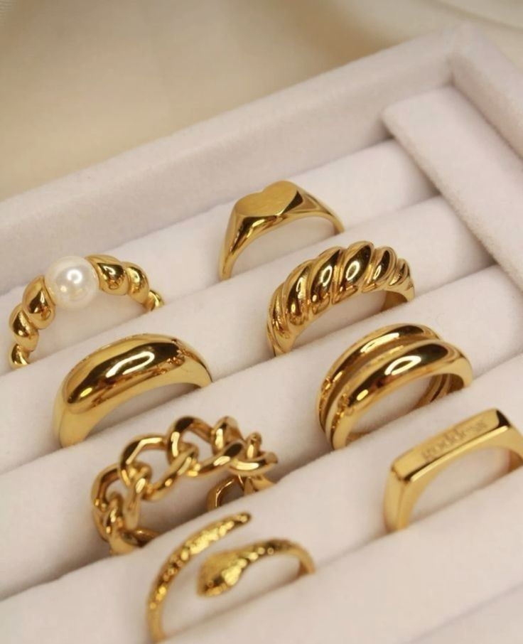
Scenario Analysis :
5. The system displays the total cost at the bottom of the shopping cart.
6. The customer reviews the total price to confirm it.
6.1 If the price is not correct The system should notify the user about the error and offer options to retry the action.The system logs the issue for technical support to resolve, and the customer can contact customer support via life chat to solve the issue.
6.2 If the price is correct the customer decide whether to proceed with the purchase or continue browsing.
6.2.1 If the customer decide to proceed with purchase the system redirects the customer to the secure payment page.
6.2.2 If the customer decide to continue browing the system sends an email reminder encouraging them to return.
Post-conditions/ Response:
The item added to the shopping cart The system calculates and displays the total cost accurately.

Slide 9
Scenario Analysis :
Comments:
The system must have permissions to send Email/Notification to the customer

Slide 10
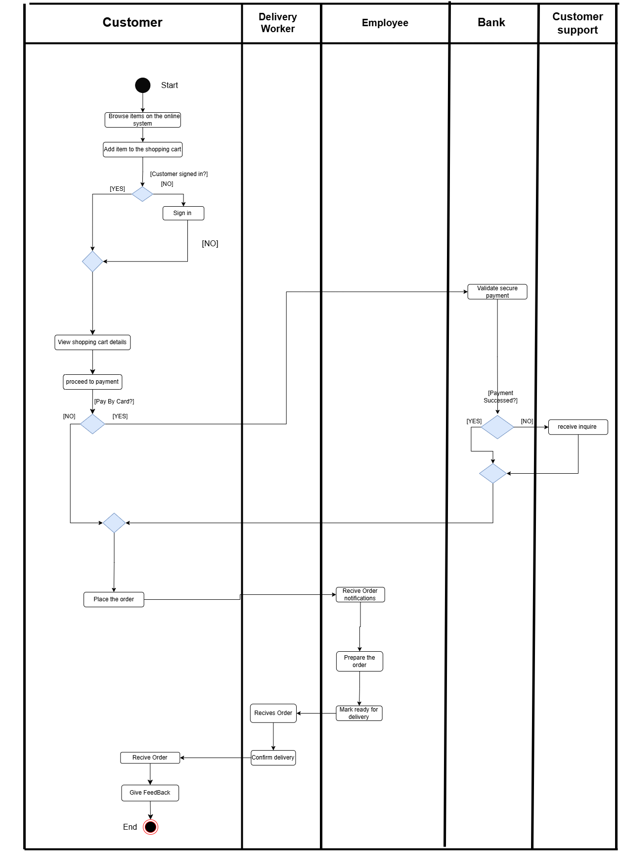
Activity Modelling

Slide 11
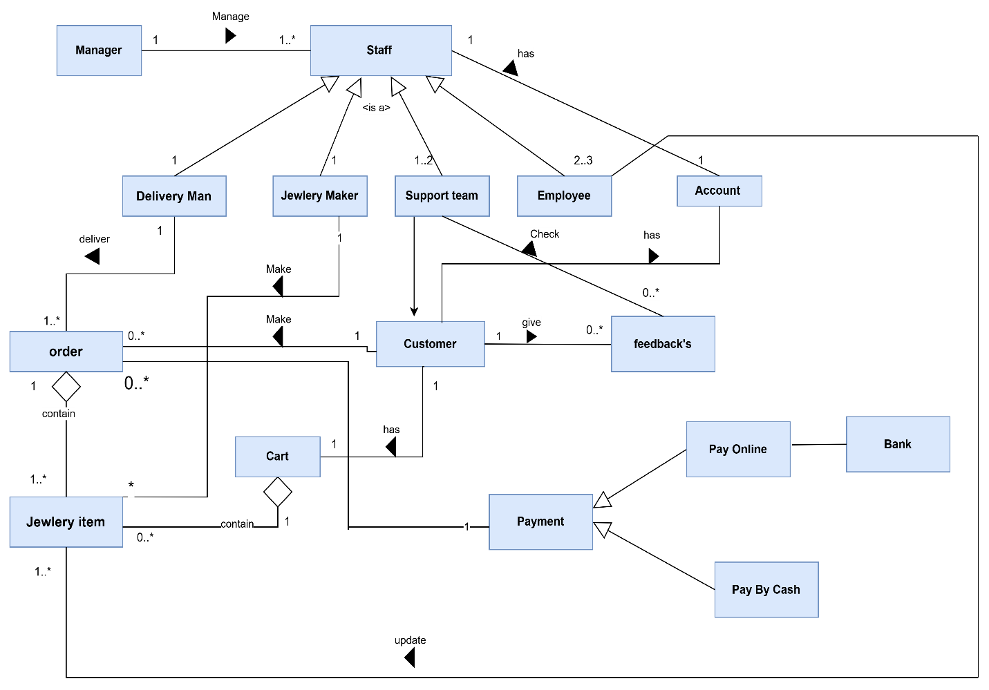
Overall Class
Diagram

Slide 12
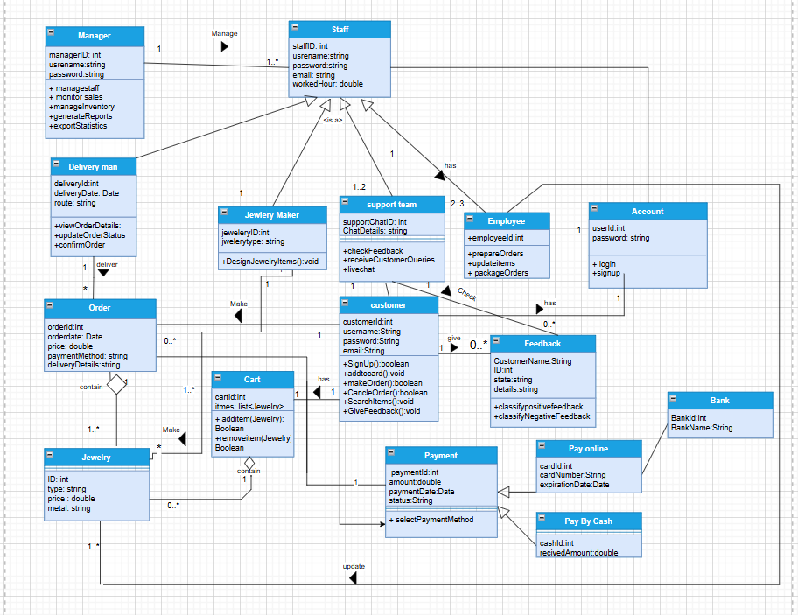
Overall (detailed)Class
Diagram

Slide 13
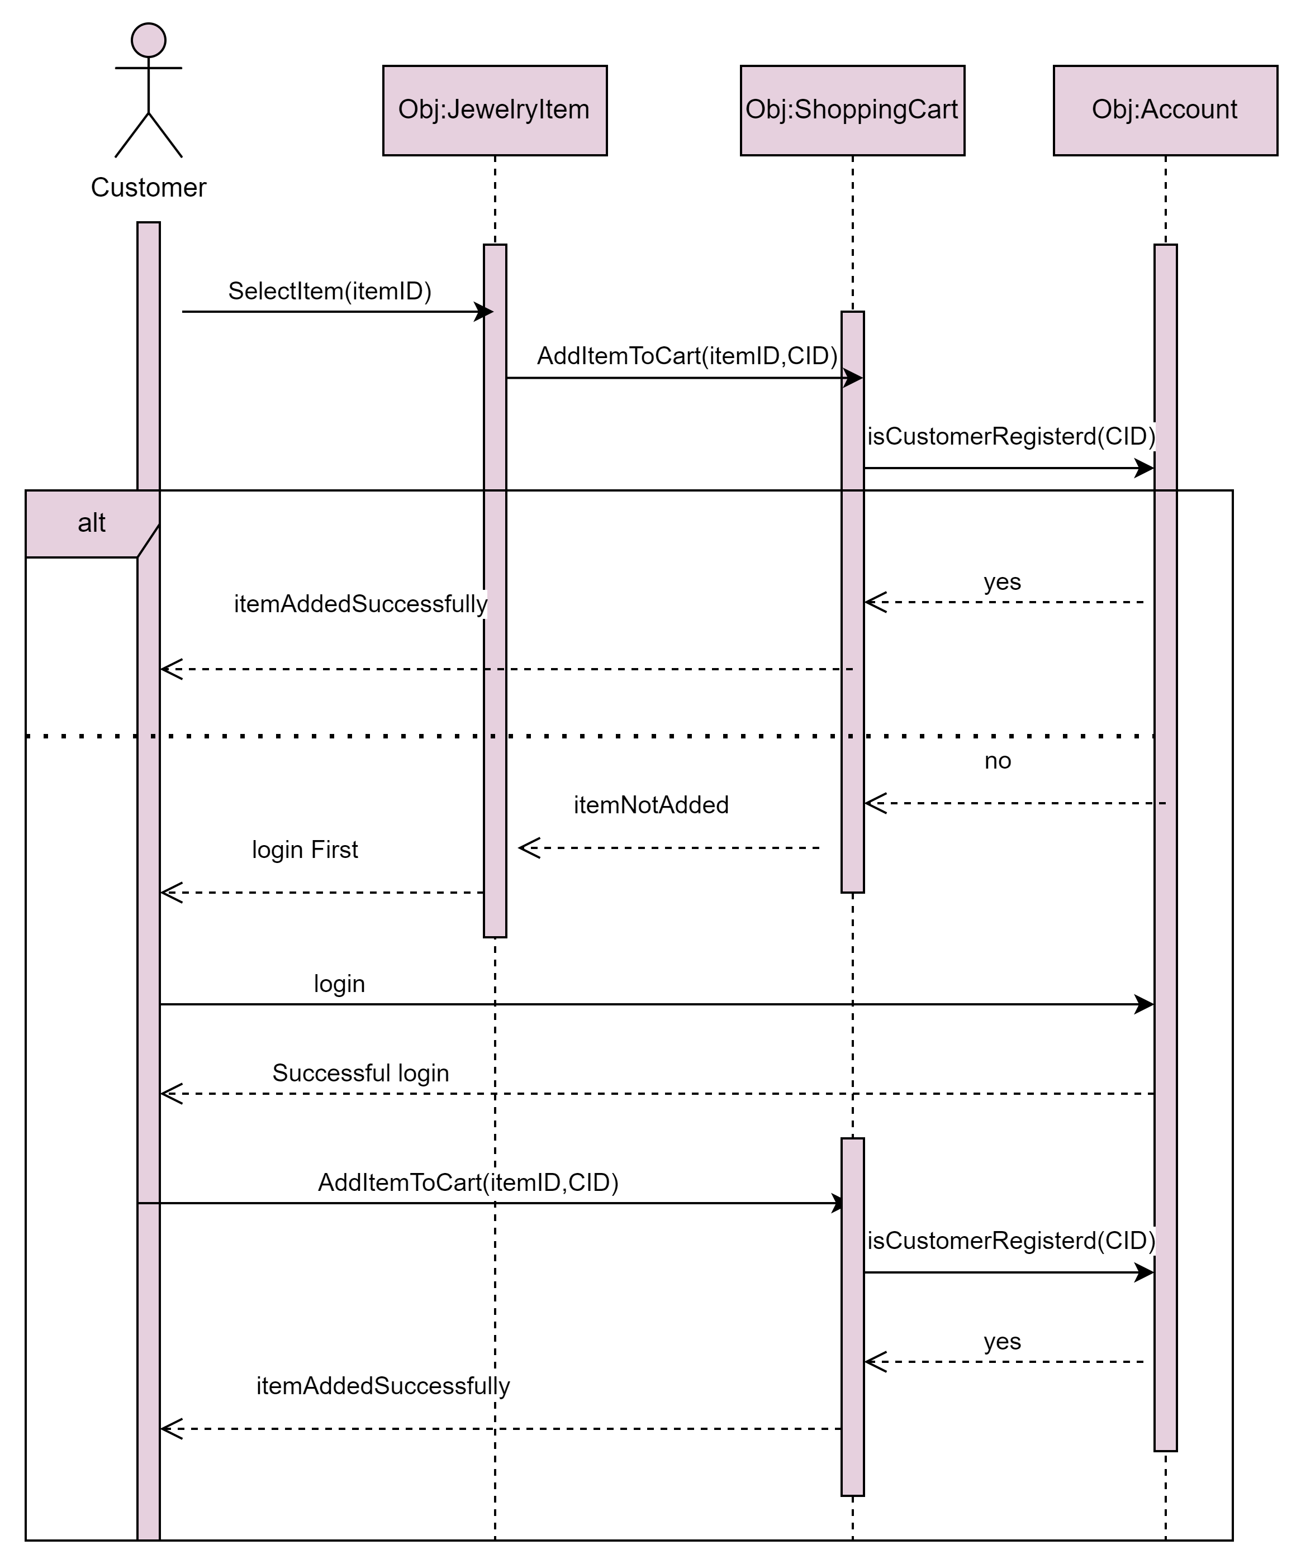
Sequence diagram

Slide 14
Design goals
General Design Goals:
1- Low Coupling
In a system with low coupling, dependencies between components or layers are minimized. Using well-defined interfaces, each component interacts with others, reducing the need to rely directly on implementation details of other components. Low coupling can be achieved by implementing a multi-layer architecture.
2-High Cohesion:
High Cohesion refers to grouping related functionality within the same layer or component. In this way, components and modules are well-defined and have a clear purpose, making a system more organized and maintainable. As an example, in a web server for a business application, entities such as Manager, Customer, Employee, Product, and Feedback are grouped together since they relate to the business's operations. It's important to place these entities in the same layer so they can interact and collaborate easily. When each component within a system has a specific set of responsibilities, it promotes modularity and well-structured architecture, which will result in high cohesion. Debugging and future development are also simplified as a result, which enhances readability and maintainability.

Slide 15
Design goals
Specific System Designs Goals:
1. User-Friendly Interface
Our system will be designed to be intuitive and easy to use, ensuring that customers of all backgrounds and technical skill levels can navigate and interact with it effectively on their first try.

Slide 16
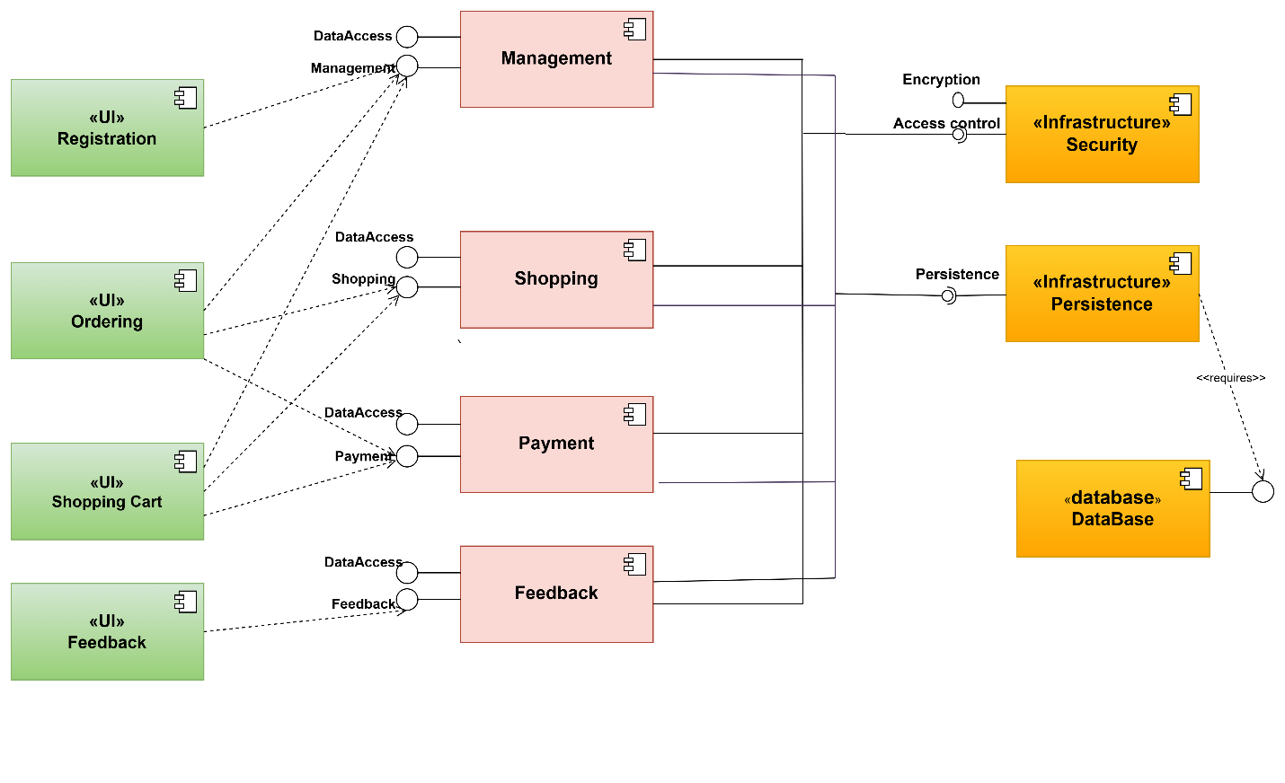
Component
diagram

Slide 17
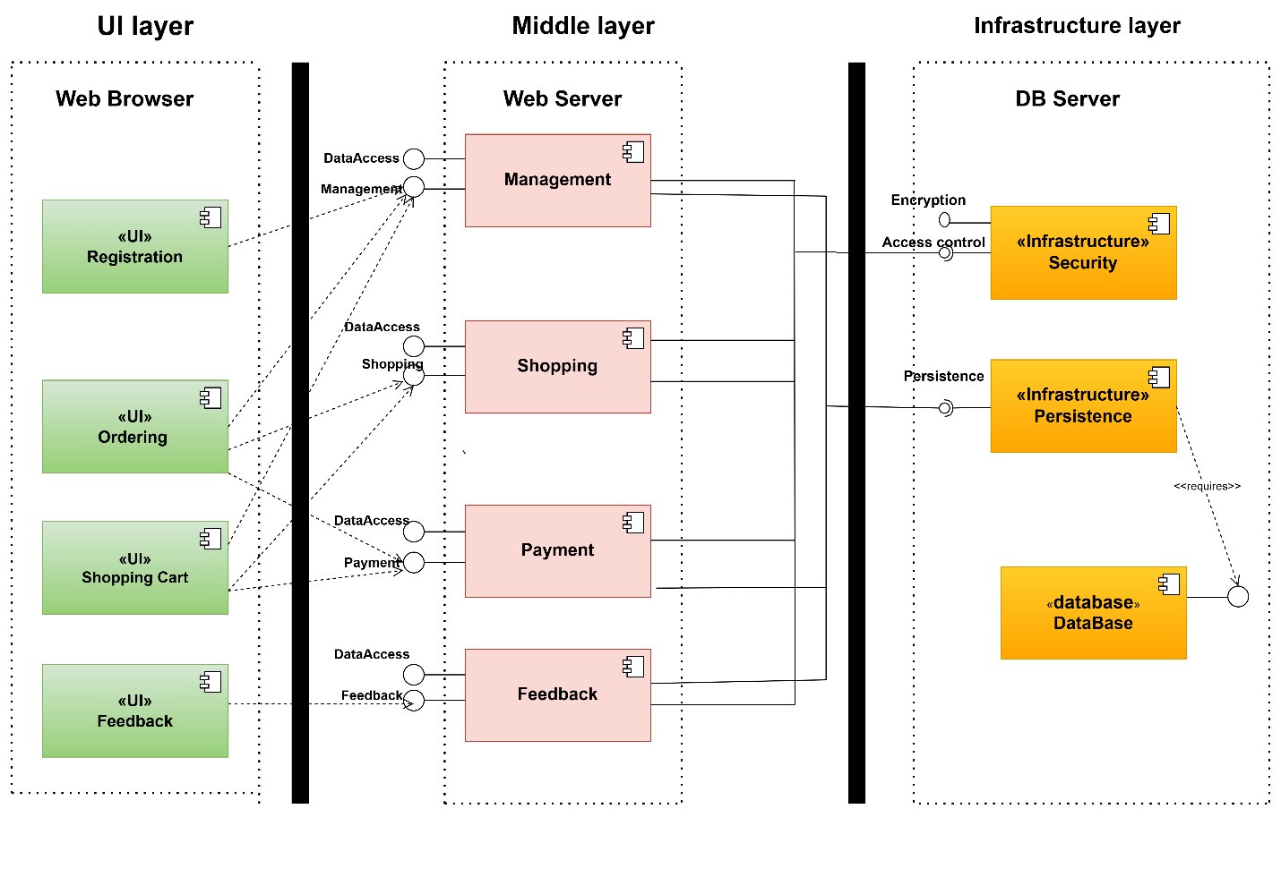
Architecture diagram

Slide 18
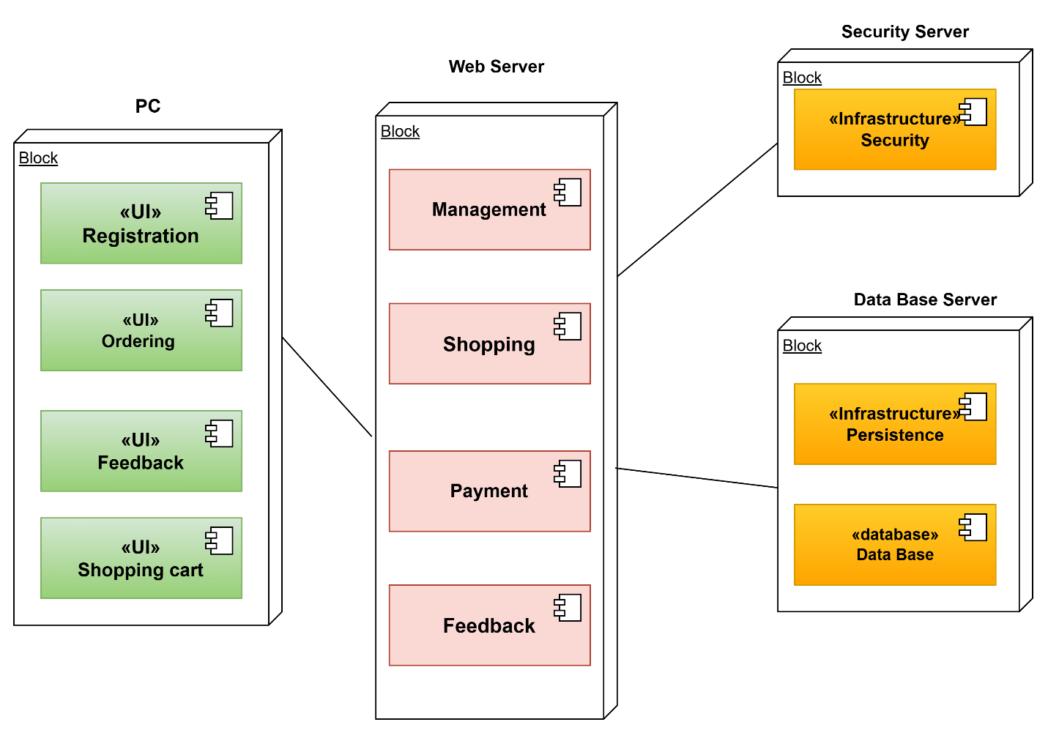
Deployment diagram

Slide 19
Thanks for watching
Hope you liked it !

